Slide 1
Flipping Assessment ‐ It Just Makes Sense
Cathy Box, Ph.D.
Lubbock Christian University
Cathy.box@lcu.edu
Twitter: @cathybox
Blog: alearningboxblog.com

Slide 2
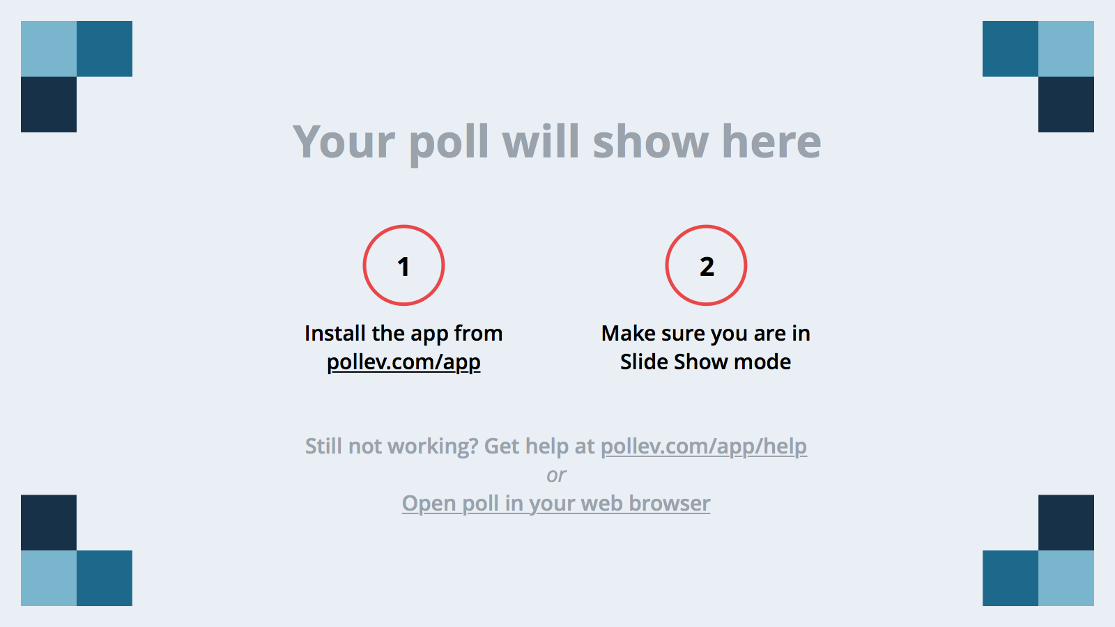
Notes:
Poll Title: How familiar are you with the flipped classroom? https://www.polleverywhere.com/multiple_choice_polls/EGJvs3qOQhMQUV7

Slide 3
Notes:
Poll Title: I flip my classroom: https://www.polleverywhere.com/multiple_choice_polls/bJdK1H5wtgU7NPj

Slide 4
The Flipped Classroom
A pedagogical model where the typical lecture and homework elements are reversed

Slide 5
Session Learning Target
Identify assessment strategies that work well in a flipped classroom
Notes:
We know in our education classes, we kill two birds with one stone. We use effective strategies to teach our pre-service students
And we model those strategies so that they will use them in their own classes

Slide 6
Changing what we do in the classroom necessitates a change in how we assess learning.
Notes:
We’ve spent a fair amount of time looking at the benefits of flipping, the pitfalls, do’s and don’ts. How to’s and transitions. Now what? We have to consider that “changing what we do in the classroom necessitates a change in how we assess the learning”. My area of expertise is formative assessment and today I’d like to share with you the keys to FA that I think have the potential to transform what goes on in the classroom.

Slide 7
Notes:
Poll Title: What is formative assessment? https://www.polleverywhere.com/free_text_polls/wxUQG9L8Aa8dVS2

Slide 8
Formative Assessment (also known as Assessment for Learning)
Formal and informal processes teachers and students use to gather evidence for the purpose of improving learning.
Jan Chappuis, 2015
Notes:
Go back to the board and see how they did. Student’s roles?

Slide 9
What the research says…
Dylan Wiliam and Paul Black
9 years, 160 different journals, 580 articles later…
Findings – A look inside the black box…

Slide 10
The Evidence
“Is there evidence that improving formative assessment raises student achievement?”
The answer is an unequivocal yes.
Strengthening the practice of formative assessment produces significant and substantial gains in student achievement.
There have been few initiatives in education with such a strong body of evidence to support a claim to raise standards.
Notes:
I have spent my entire academic career studying FA and its use in the classroom. Factors that constrain or facilitate its use. Why some teachers use it and some do not. I have found that traditional instruction is perhaps one of the biggest impediments to it’s use.

Slide 11
A flipped classroom provides the perfect platform for leveraging the power of formative assessment and may be the key ingredient to its success
Notes:
One of the biggest impediments to implementation is traditional instruction. Now that we are beginning to flip our classrooms
For those conducting research, if you want positive results, I guarantee that implementing the process of formative assessment will yield increased student learning.
Work at higher level Blooms
Professor as coach or facilitator
Ongoing assessment and feedback
Minimize grading papers
True assessment of learning outcomes

Slide 12
Elements of formative assessment
Clarifying, sharing, and understanding learning intentions and criteria for success
Engineering effective classroom discussions, activities, and learning tasks that elicit evidence of learning
Providing feedback that moves learning forward
Activating learners as instructional resources for one another
Activating learners as owners of their own
learning Dylan Wiliam

Slide 13
1. Clarifying, sharing, and understanding learning intentions and criteria for success
Using examples of strong and weak work
TPS criteria for rubric
Give students example of poor work
Students add criteria
Give students example of strong work
Students add criteria
Then give them the rubric you’ve prepare – look for commonalities
Have them grade weak work and share with the class –
must use the language of the rubric
Repeat with strong work
Notes:
They have watched a video the night before – a lecture about writing a persuasive essay. You are about to make their assignment.

Slide 14
2. Engineering effective classroom discussions, activities, and learning tasks that elicit evidence of learning
Graphic organizers while watching at home
Classroom group-work and presentations
Opportunity for feedback
Makes the learning visible

Slide 16
Notes:
Poll Title: What are attributes of effective feedback? Use one word. https://www.polleverywhere.com/free_text_polls/AhQIrdmhEy3WtCg

Slide 17
Feedback
Offer regular, descriptive feedback during the learning
The presence of feedback does not improve learning….It is the quality that determines its effectiveness
Attributes of effective feedback
Directs attention to the intended learning, pointing out strengths and offering specific information to guide learning
Occurs during learning, while there is still time to work on it
Does not do the thinking for the student
Limits the corrective information to the amount of advice
the student can act on
Notes:
Assignments that students work on during their flipped class must result in visible learning
Group presentations, posters, discussion, board work, (Venns, problems, work product)
The flipped classroom provides the perfect opportunity to give students effective feedback in a timely manner that can be used to move the learning forward.

Slide 18
The flipped classroom provides the perfect opportunity to give students effective feedback in a timely manner that can be used to move the learning forward.

Slide 19
3. Providing feedback that moves learning forward
Verbal feedback
Group feedback form

Slide 20
4. Activating learners as instructional resources for one another
TSAR – Think, share, advise, revise

Slide 21
5. Activating learners as owners of their own learning
Tracking my progress example

Slide 22
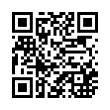
For handouts and more information on Assessment for Learning
http://www.alearningboxblog.com

